Slide 1

ELEAPP Your one stop electronics destination !
Front End Development Project ST-I
BY – Aayushi Gupta (2010990011)
G-5
Subject Expert - Mr. Lavish Arora

Slide 2
Acknowledgements
I would like to extend my heartiest gratitude to my parents who identified the capabilities in me and invested in me so as to bring me here today . Another heartfelt thanks to my mentors and the subject experts who trained me and helped bring the best out of me. I would also like to thank my friends and peers who guided me through this project.

Slide 3
About ELEAPP
ELEAPP is your one stop electronics shopping website model which works for providing the best customer service and strives for the best customer experience of online shopping ever !

Slide 4
Appearance and Design
The color scheme that is being chosen for the website is a subtle and a basic one that is a blend of white , teal and tones of grey.
There are hover effects over various elements in various sections to give the webpage a more finer and a smoother UE.
The effects so far have only been included through CSS transitions , transform and webkit attributes.

Slide 5
What can be improved ?
The project has my 100% as to what comes out of the best of my knowledge but there is always a room for improvement .
A lot of future advancements scopes and ideas are already planned and It will be made sure that those are implemented.
The back end technologies are yet to be added and a lot of animation and transitions are also to be included !
Many features are also not currently present due to lack of resources.

Slide 6
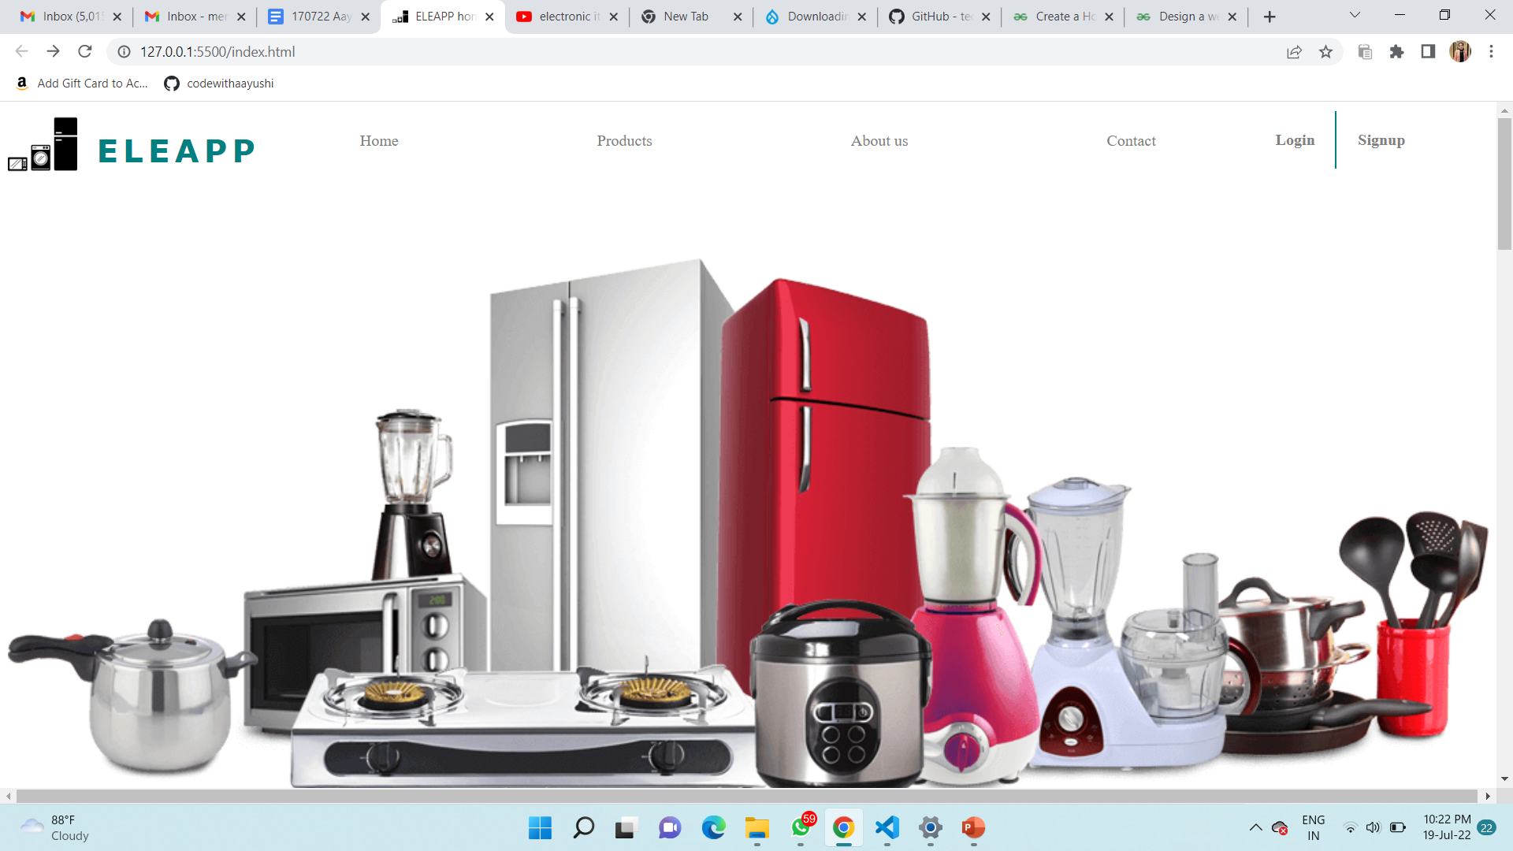
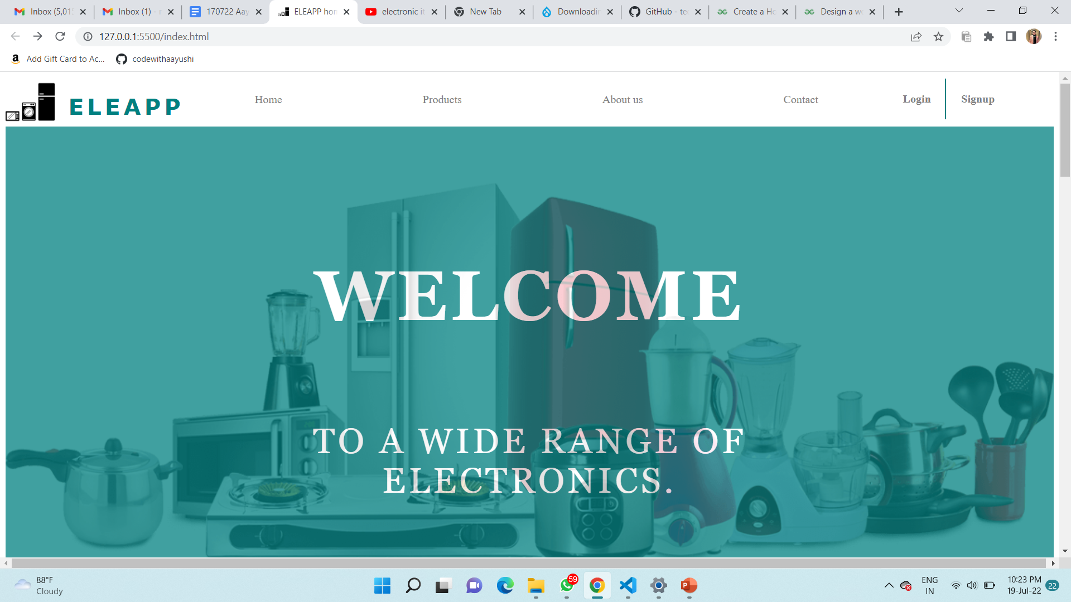
Home
Page
(Cover)
On hover

Slide 7
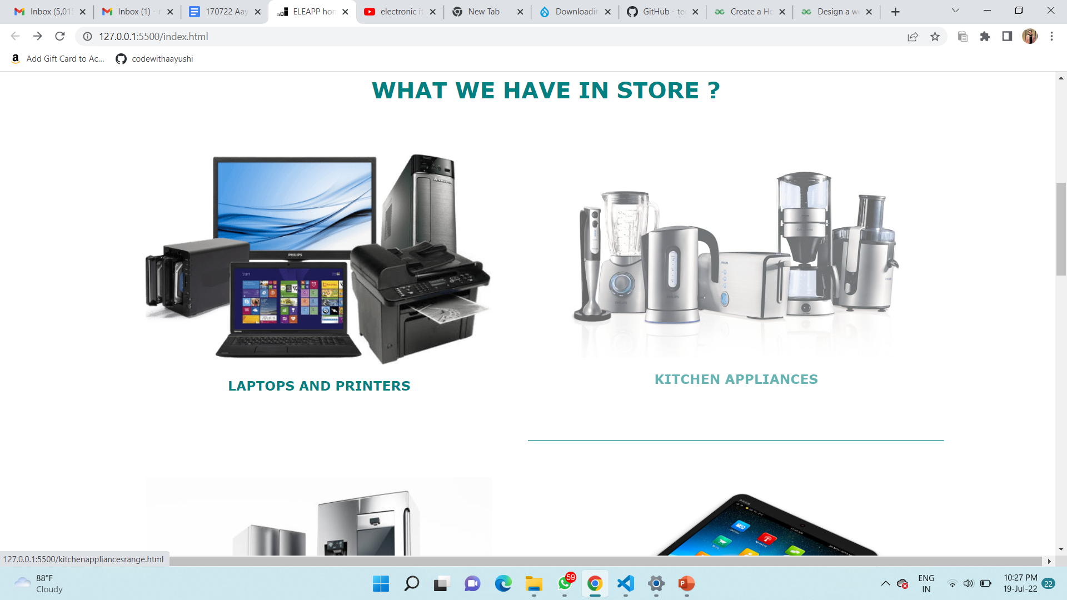
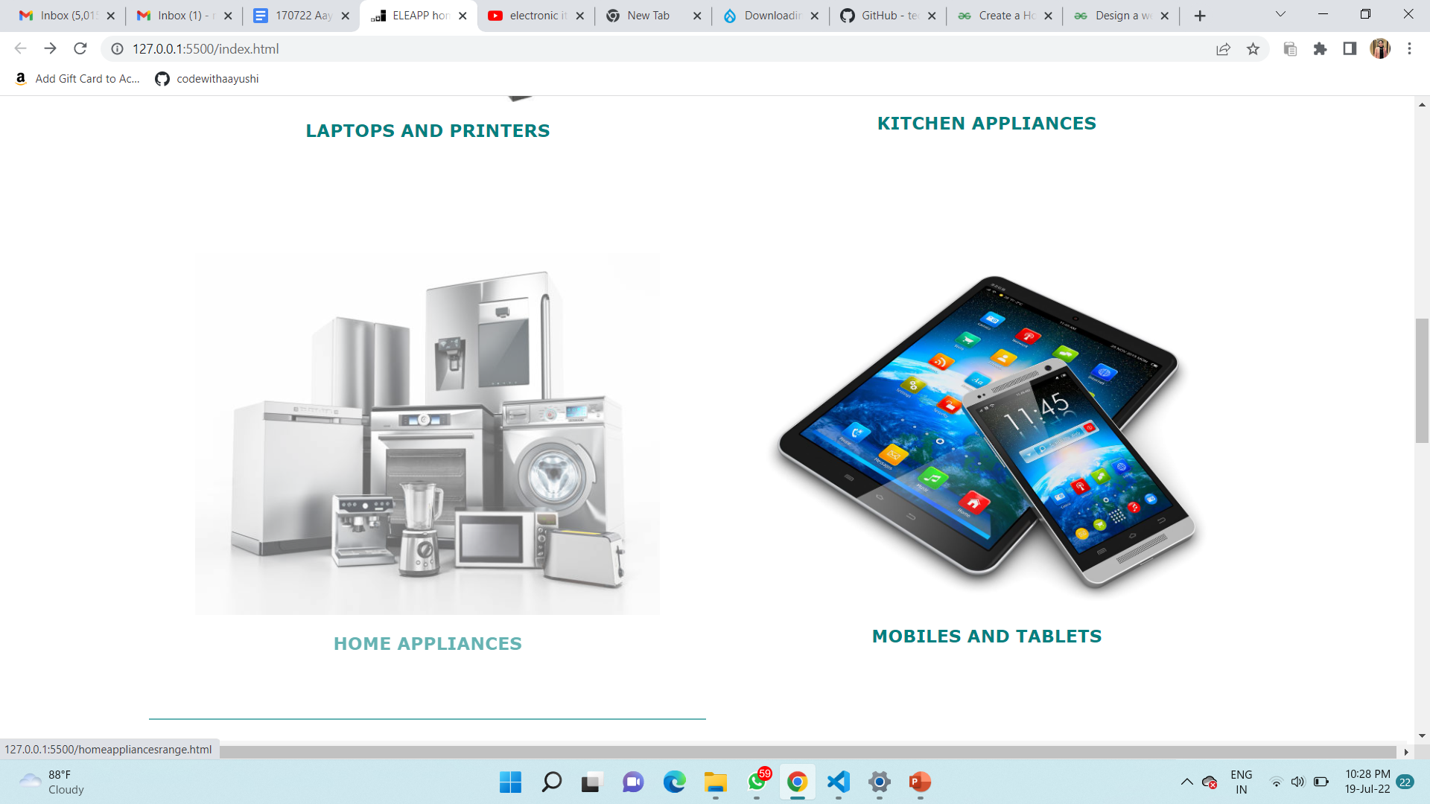
Home
Page
(Products we specialize in )

Slide 8
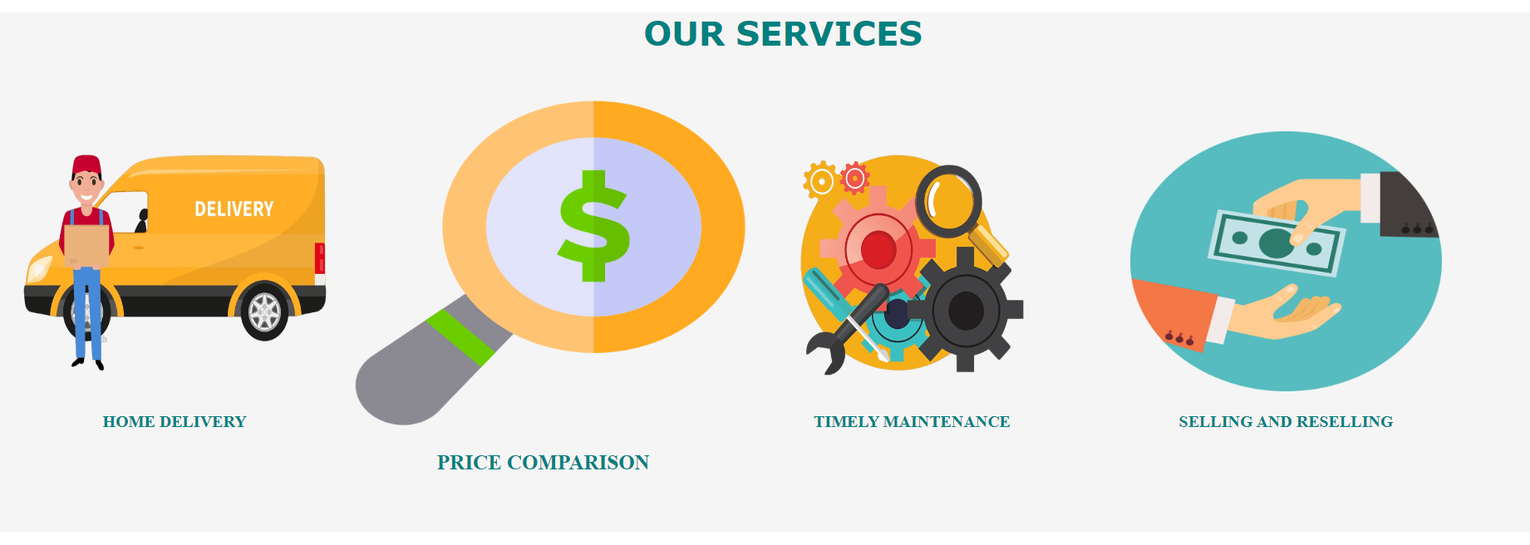
Home
Page
(Our Services )

Slide 9
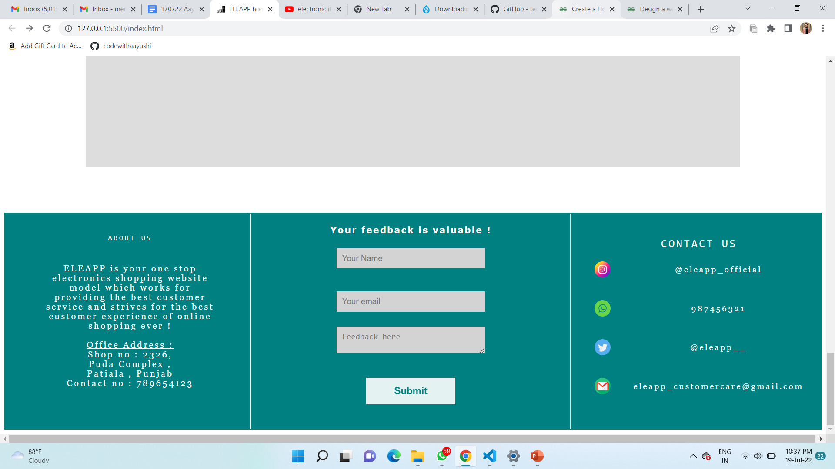
Home
Page
(Footer Section)

Slide 10
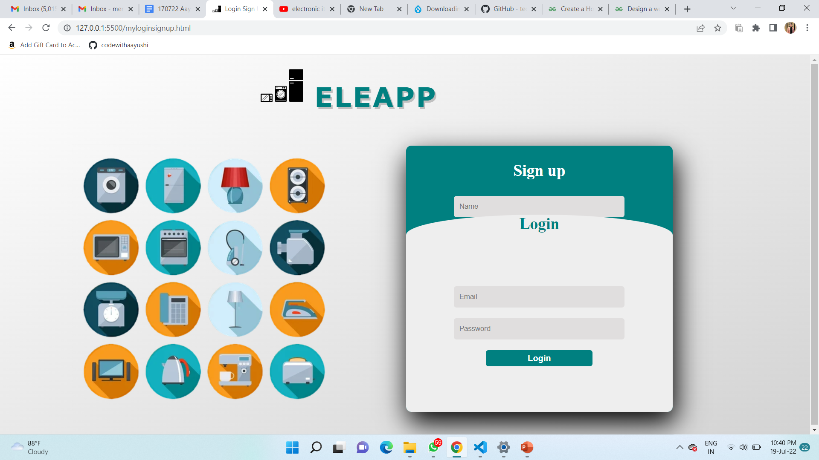
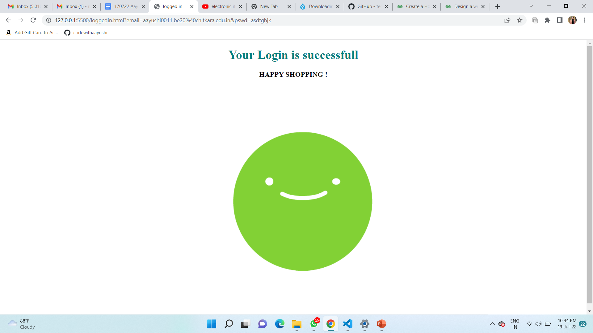
Login
Page
(for existing users)

Slide 11
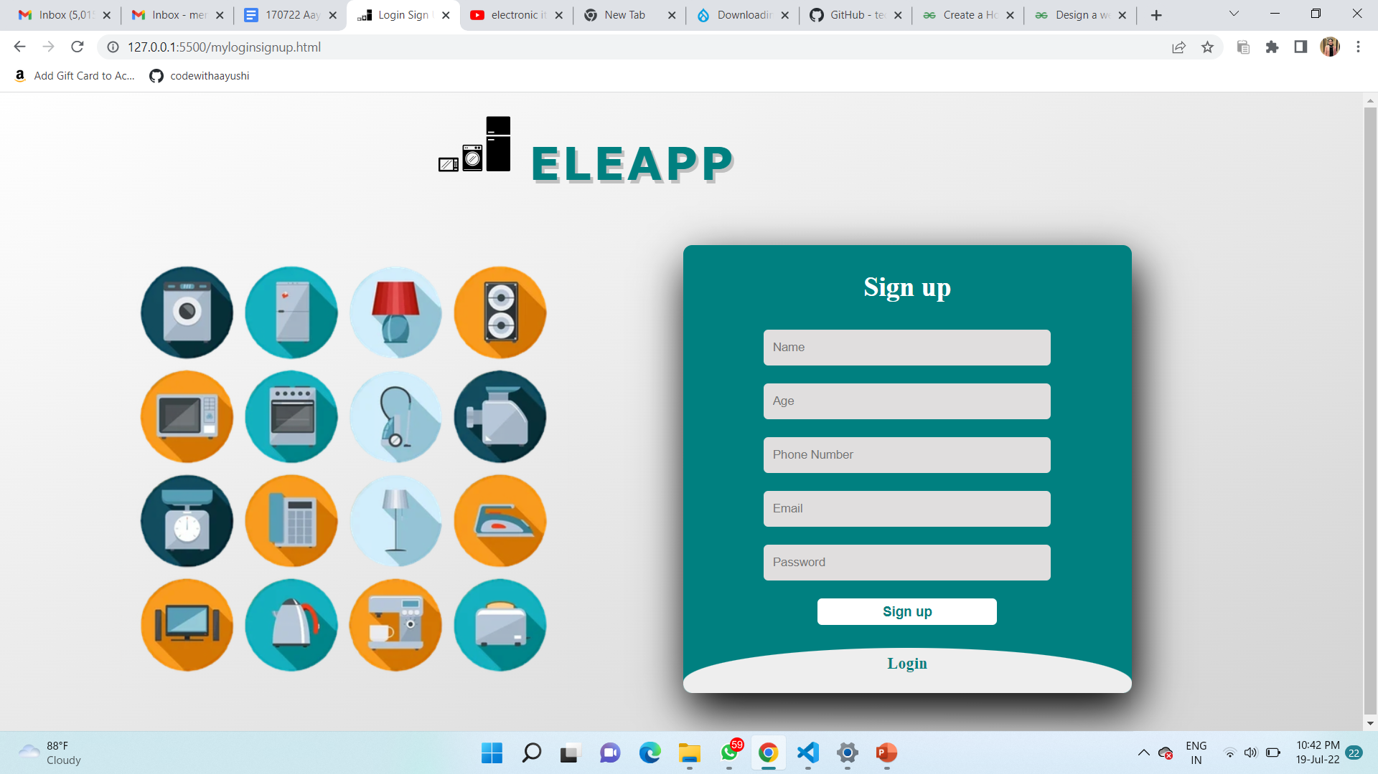
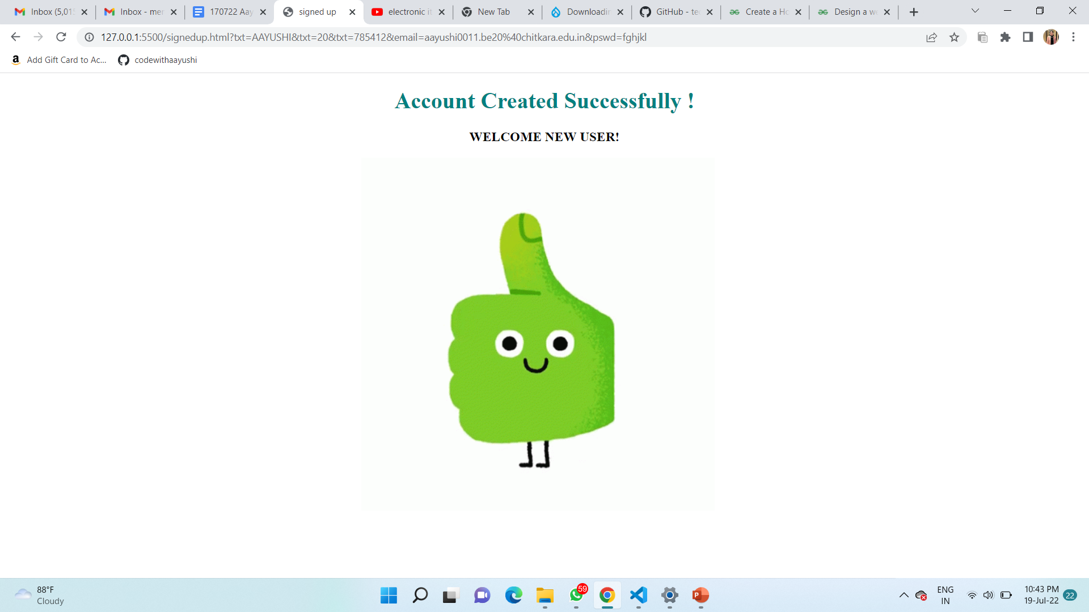
Sign Up
Page
(for new users)

Slide 12
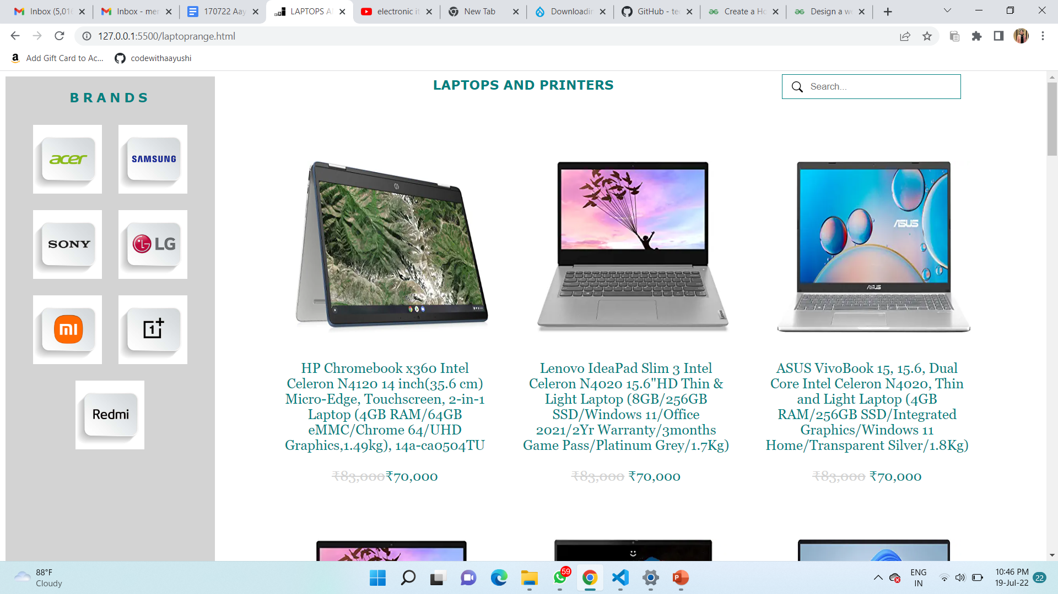
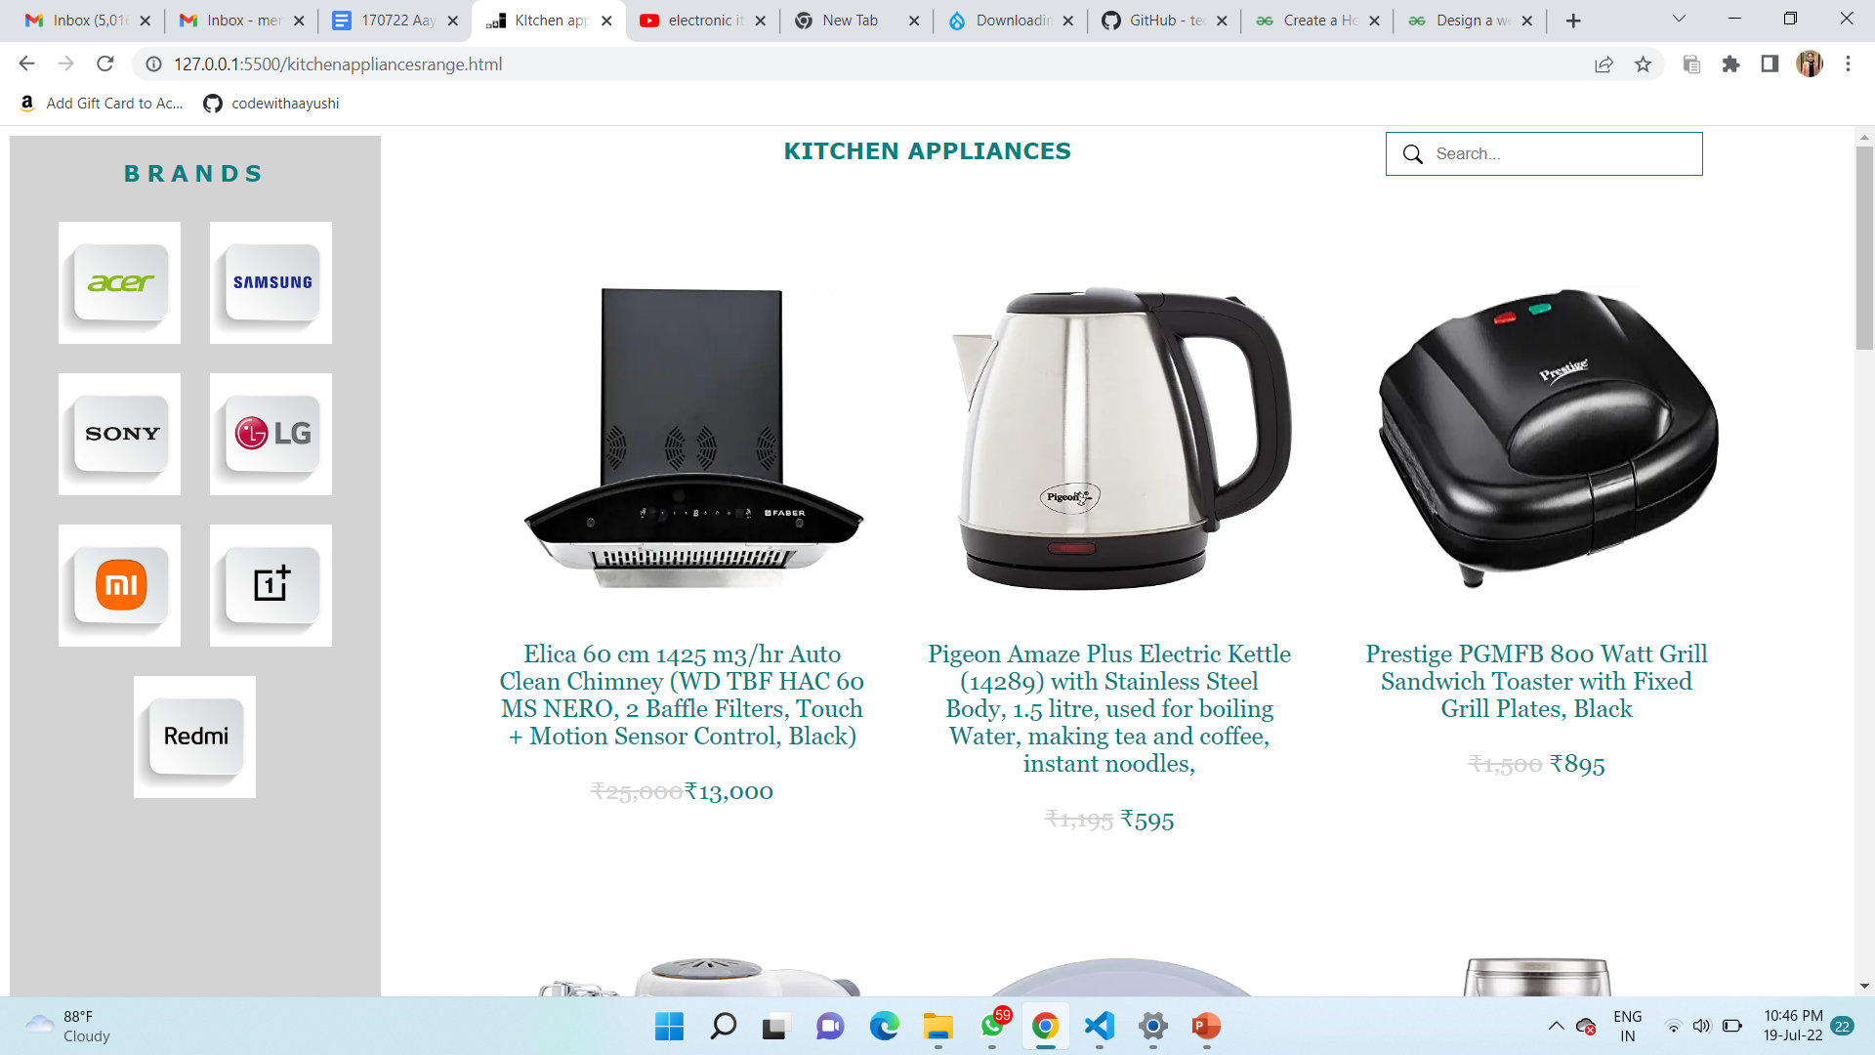
Products Range

Slide 13
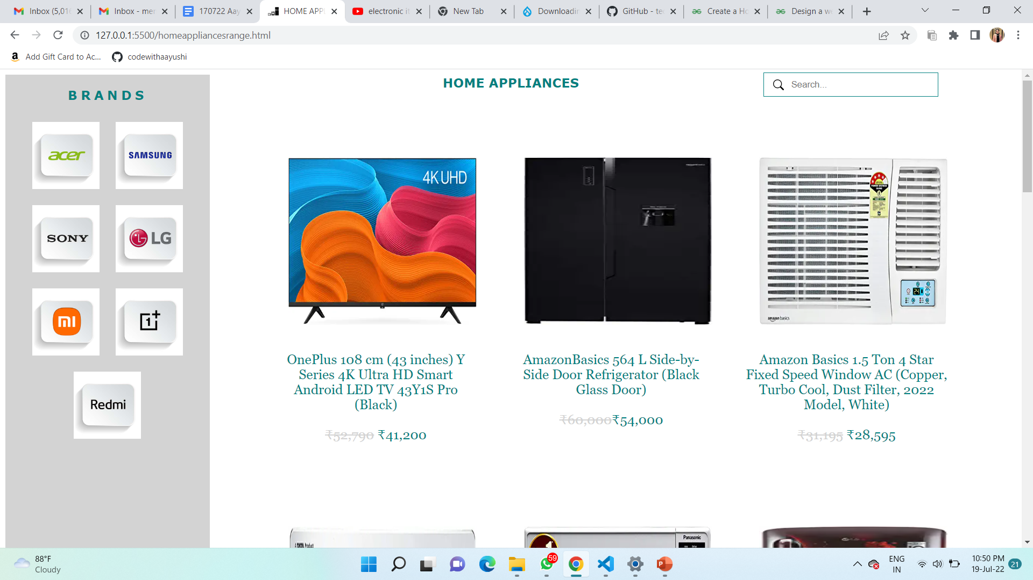
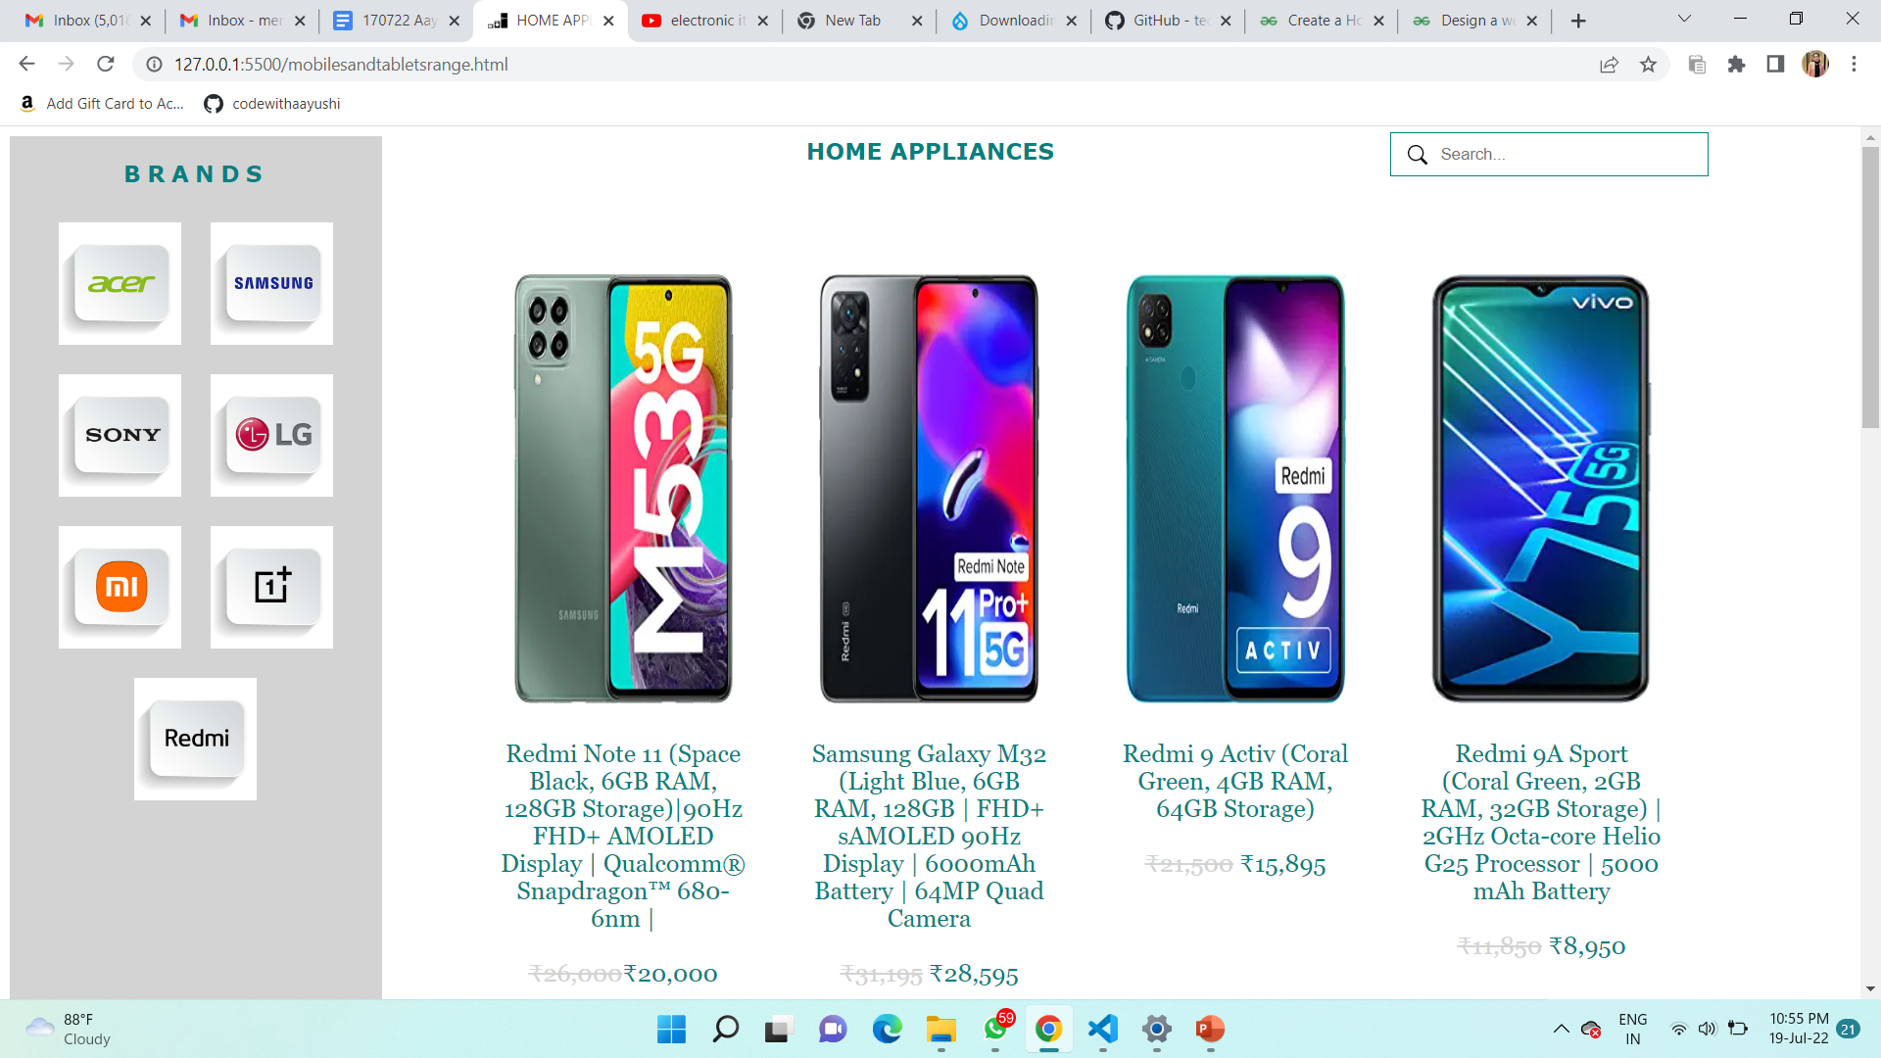
Products Range

Slide 14
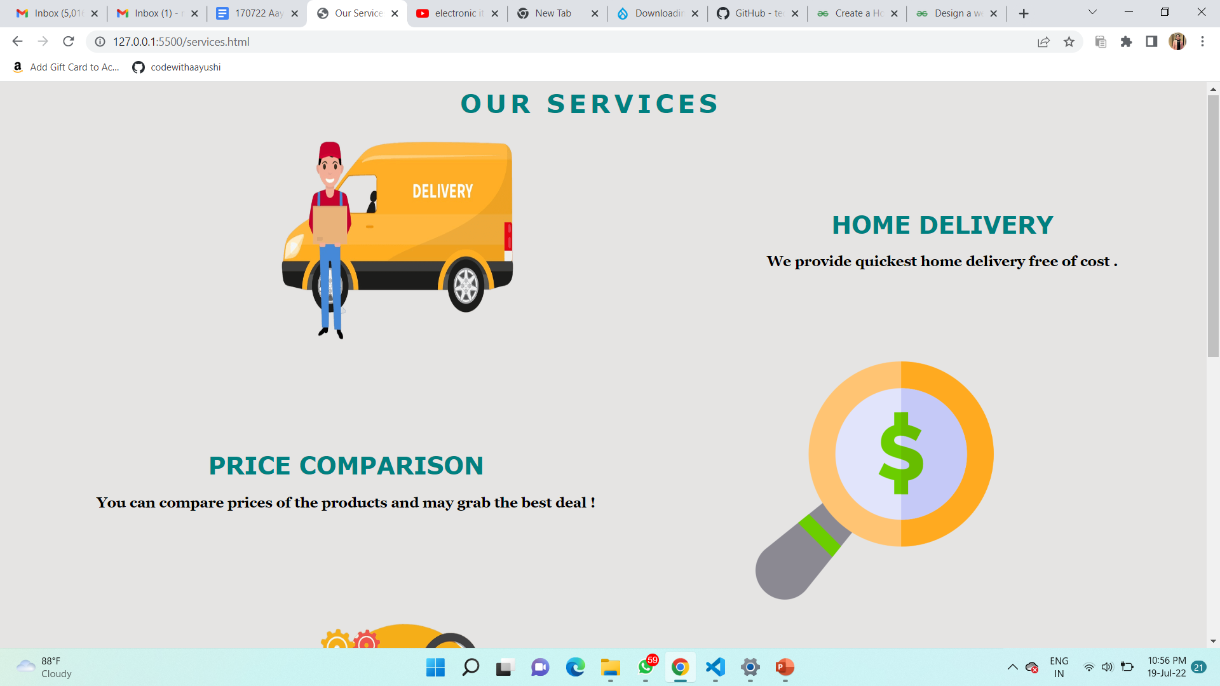
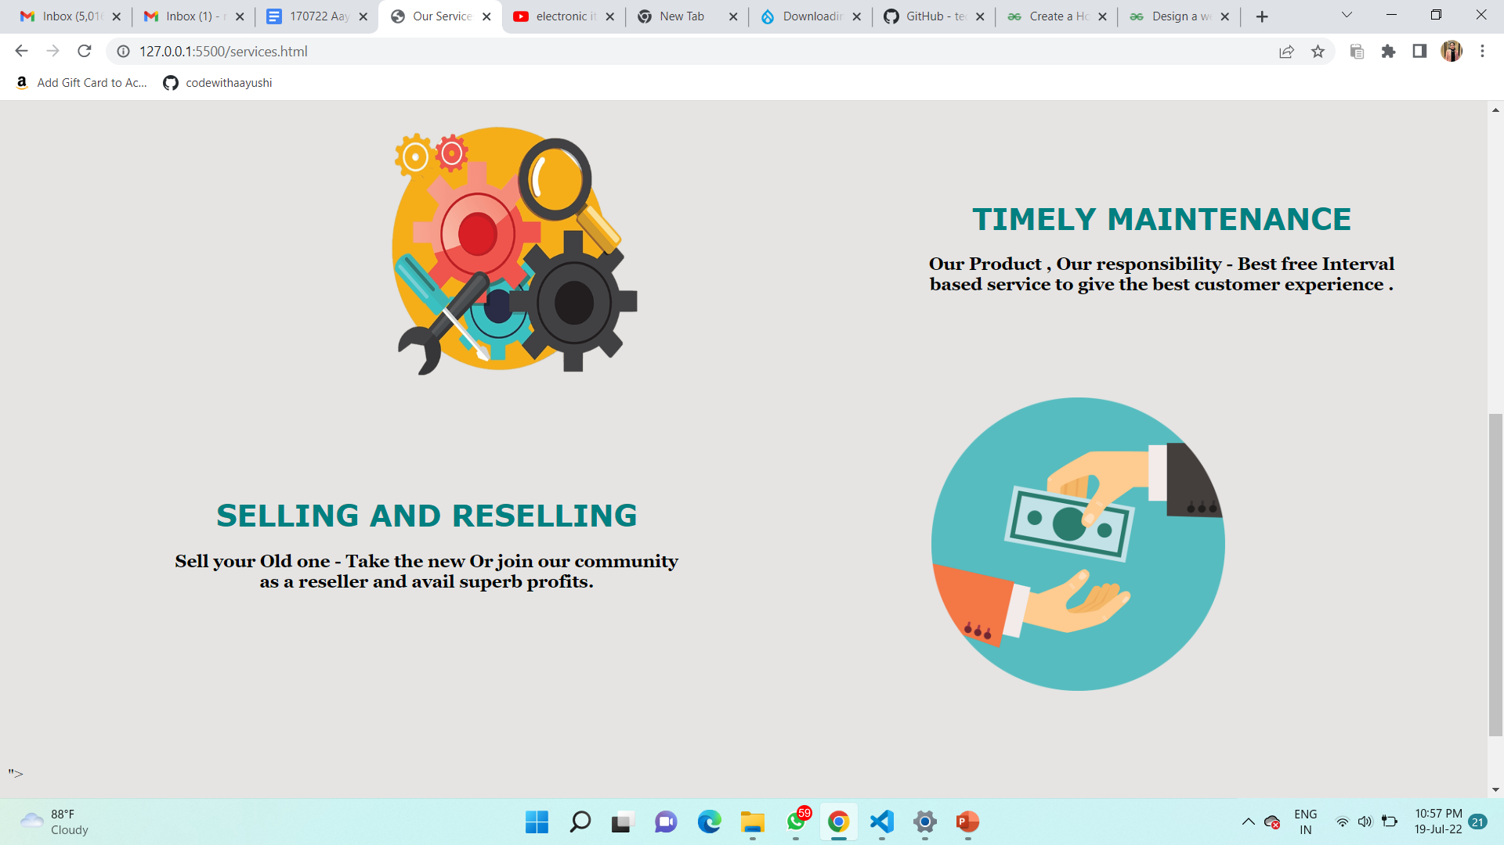
Our Services

Slide 15
Thank You

